Slide 1
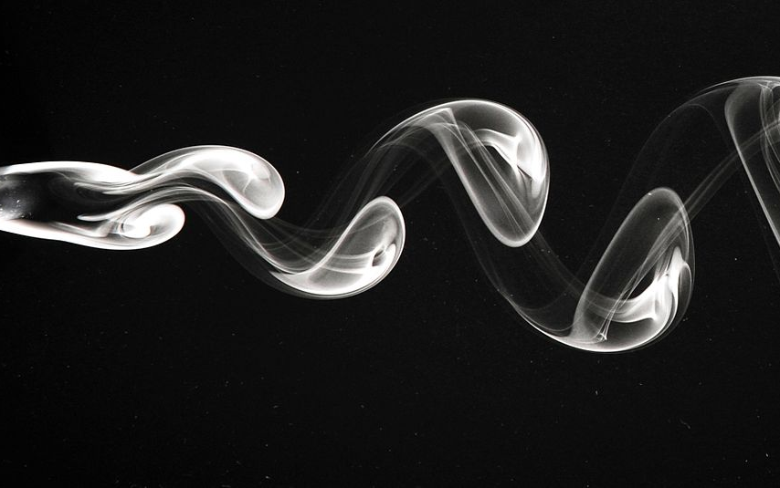
MAE 210B – Bluff Body Turbulence
Federico Zabaleta and Logan Halstrom
March 14, 2018

Slide 2
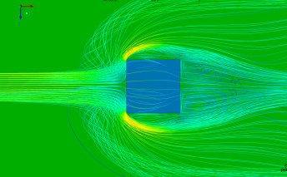
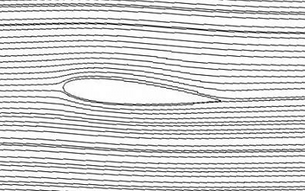
Bluff vs. Streamlined Bodies
Recirculation Zone
Drag = Friction drag + Pressure drag
Friction drag dominates streamlined body (attached BL)
Pressure drag dominates bluff body
Separated flow/no pressure recovery
Constant pressure in recirculation zone called “base pressure”
Separated shear layer
Wake
Boundary Layer
Bluff/Blunt Body
Streamlined Body
Notes:
Before we talk about bluff body flow, need to define
Bluff = Blunt
Streamlined body: attached streamlines, friction drag
Bluff body: flow regions, base pressure, pressure drag

Slide 3
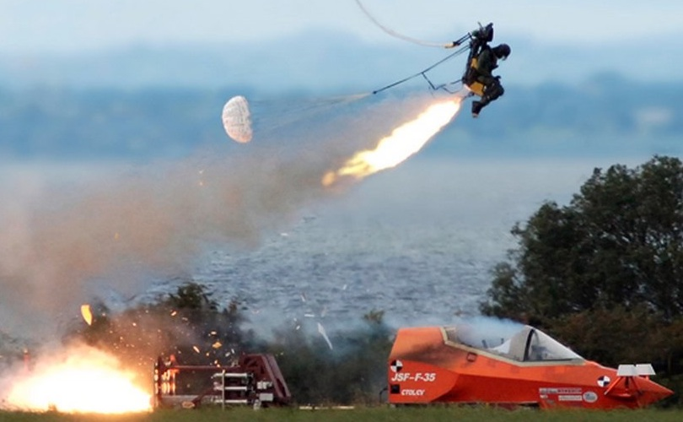
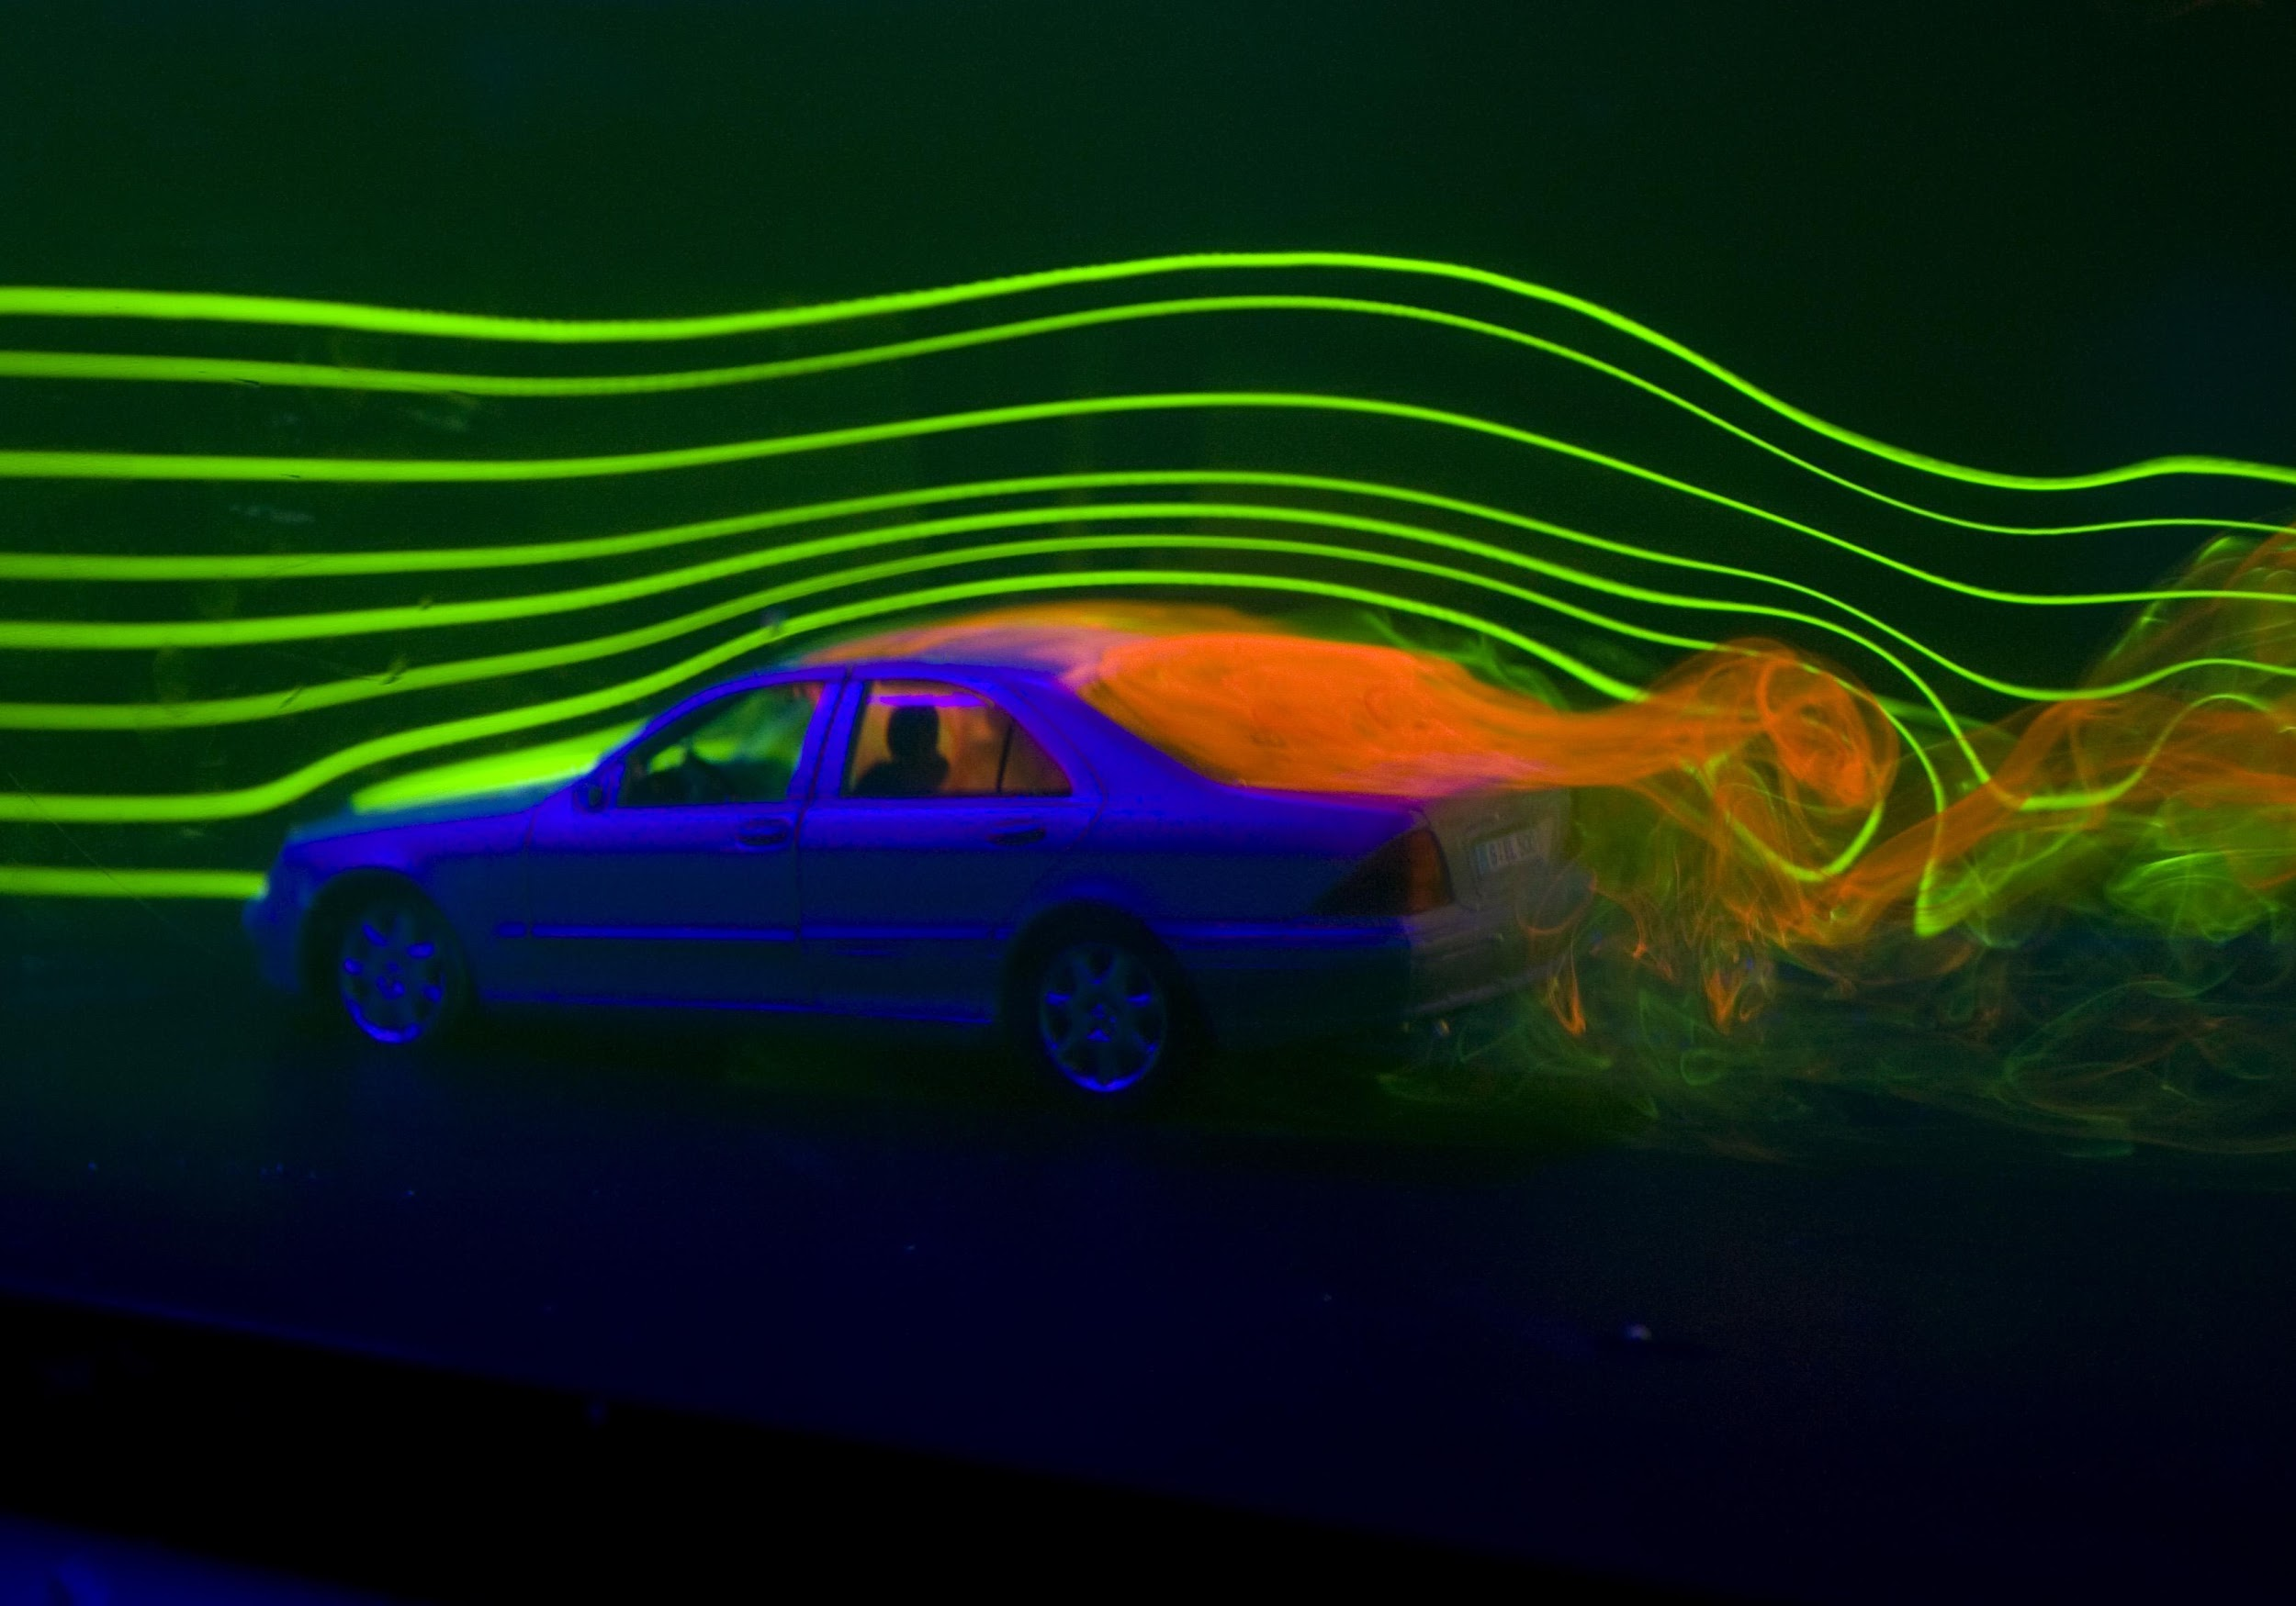
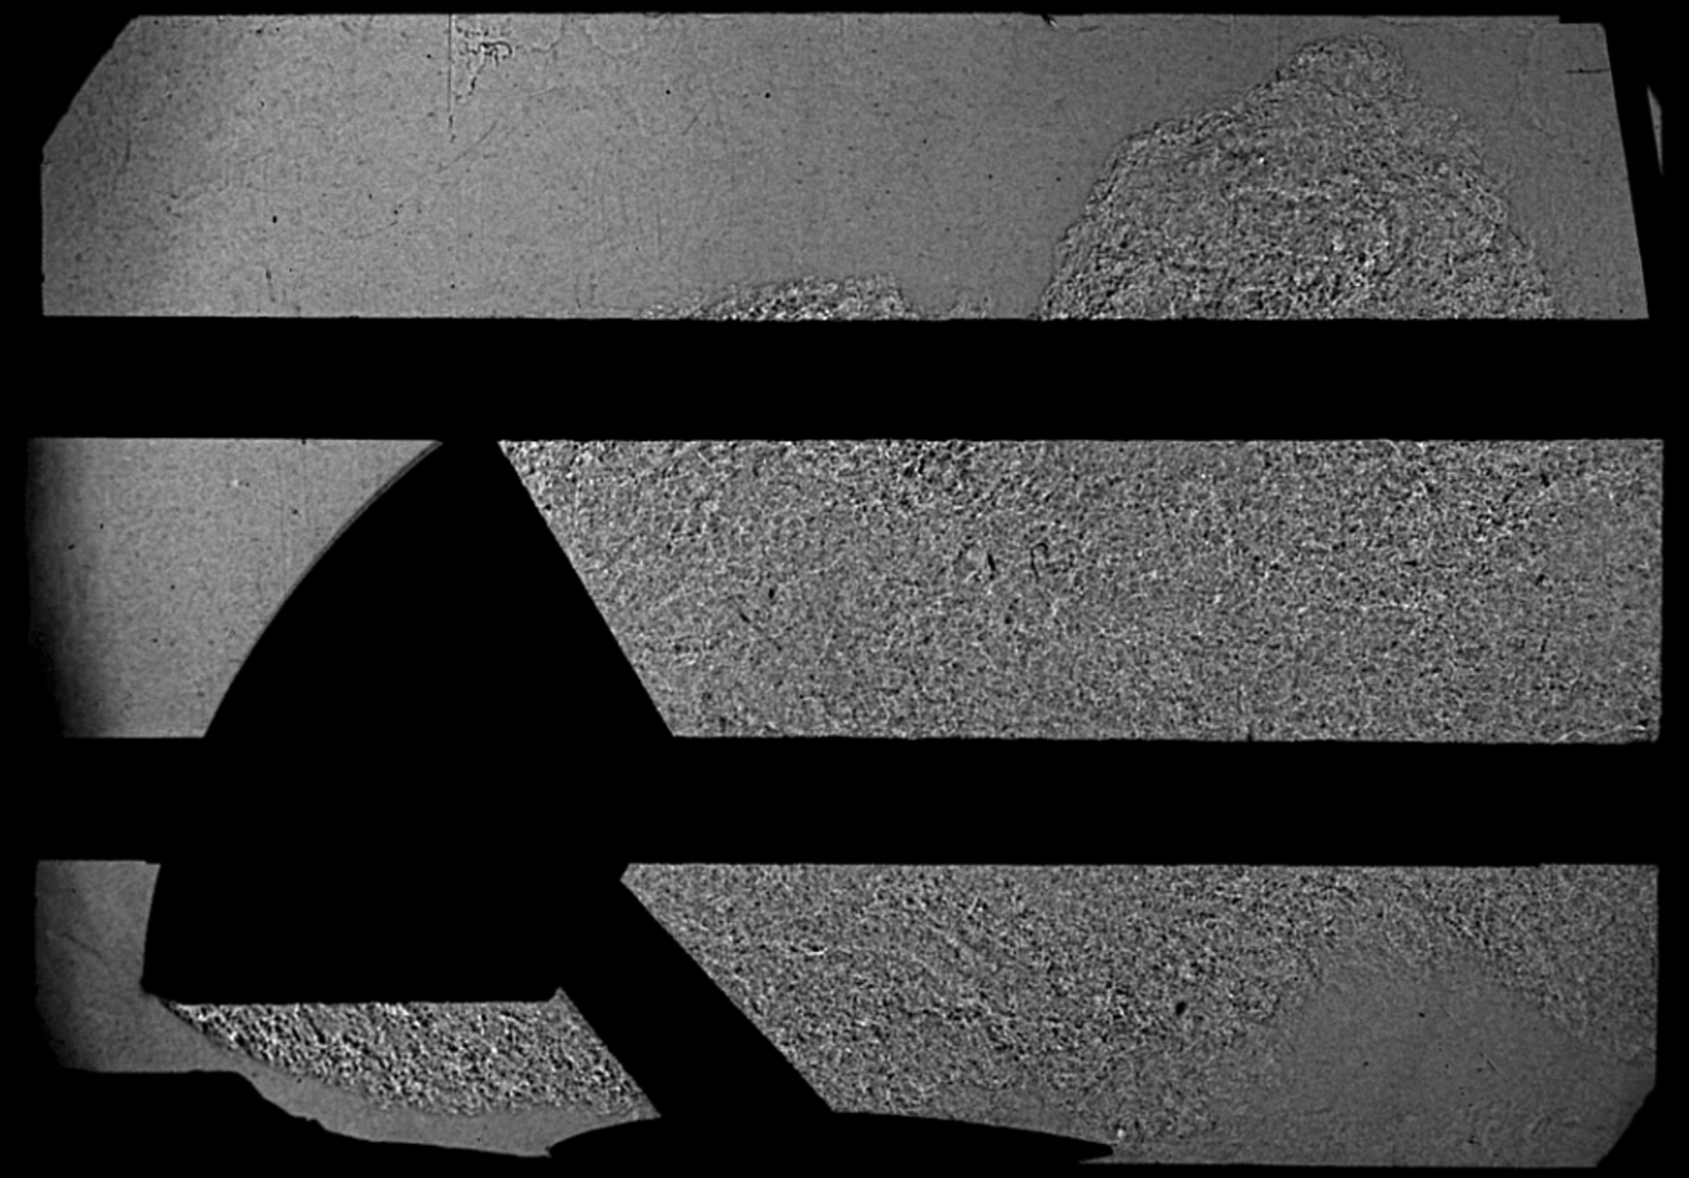
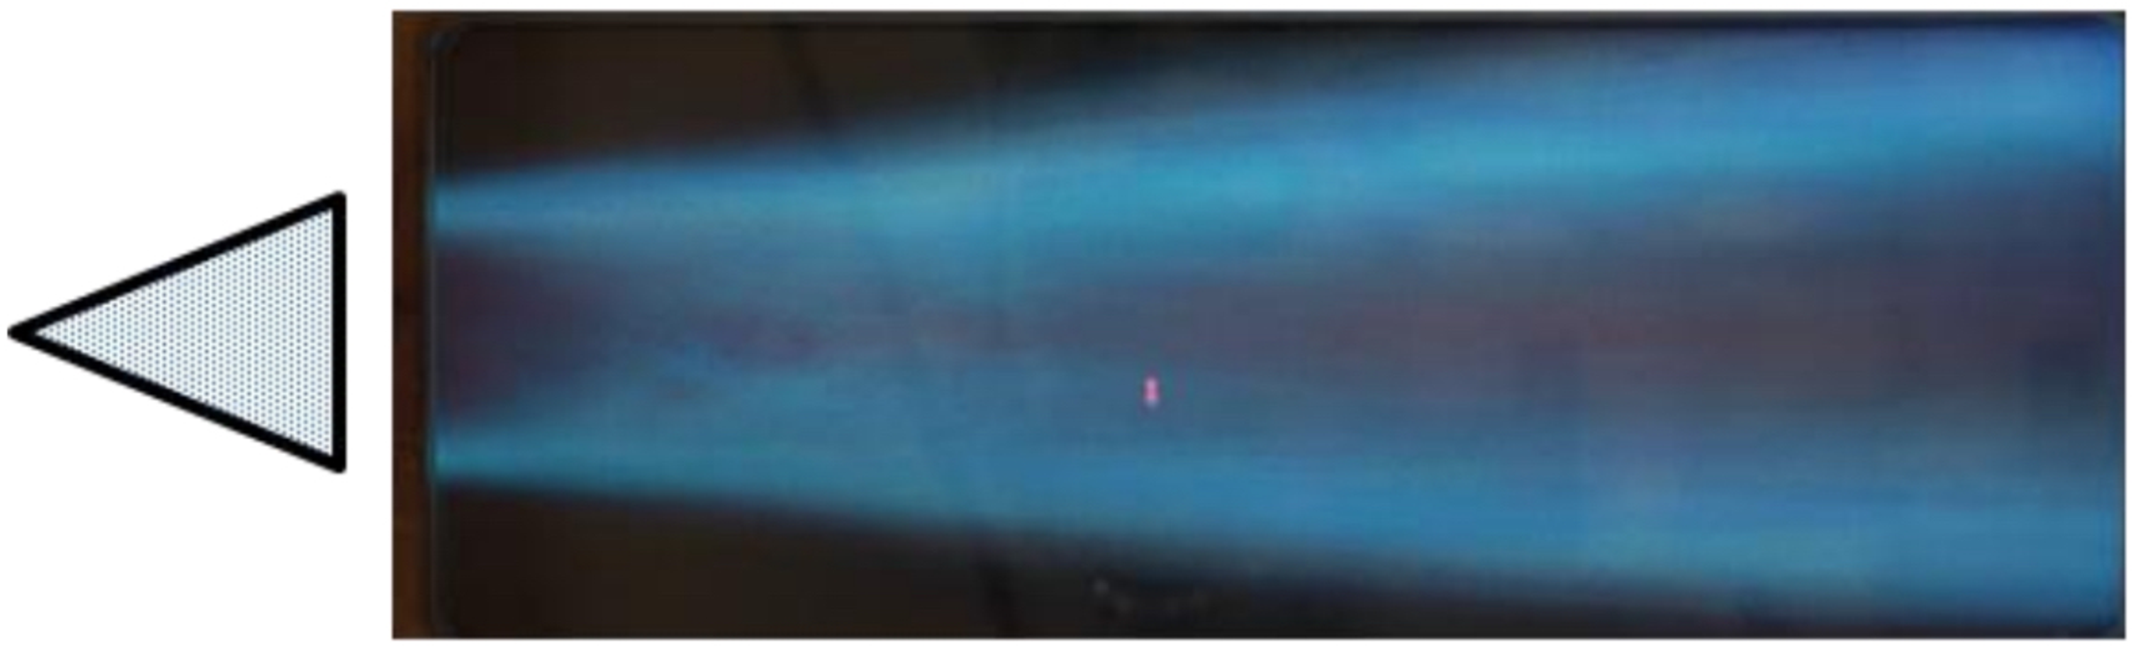
Real-World Applications
Concerns: acoustics, vehicle stability, buffeting/unsteady loads, mixing, etc.
Human, Ejection Seat, and Parachute
Passenger Vehicle Wake
Martin-Baker
NASA/Eric James (2017)
Reentry Capsule Subsonic Wake
Ross et. al (2013)
Bluff Body Flame Holder
Tanaka (2013)
Notes:
Real world applications and concerns with bluff body flow
Cube in previous slide could be building in a city
Car: acoustics in passenger cabin
Capsule: stability of reenty
Ejection Seat/Human/Parachute: Unsteady aerodynamics/buffeting
Combustor: Flame holder slows flow, creates region for ignition

Slide 4
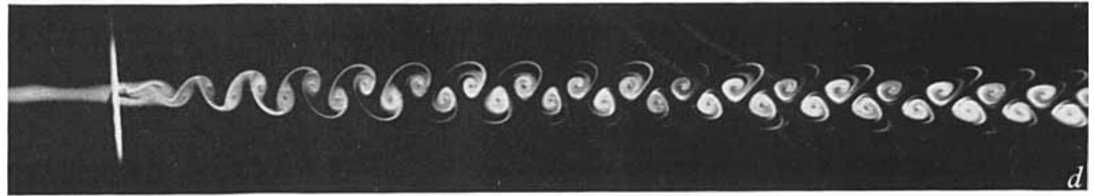
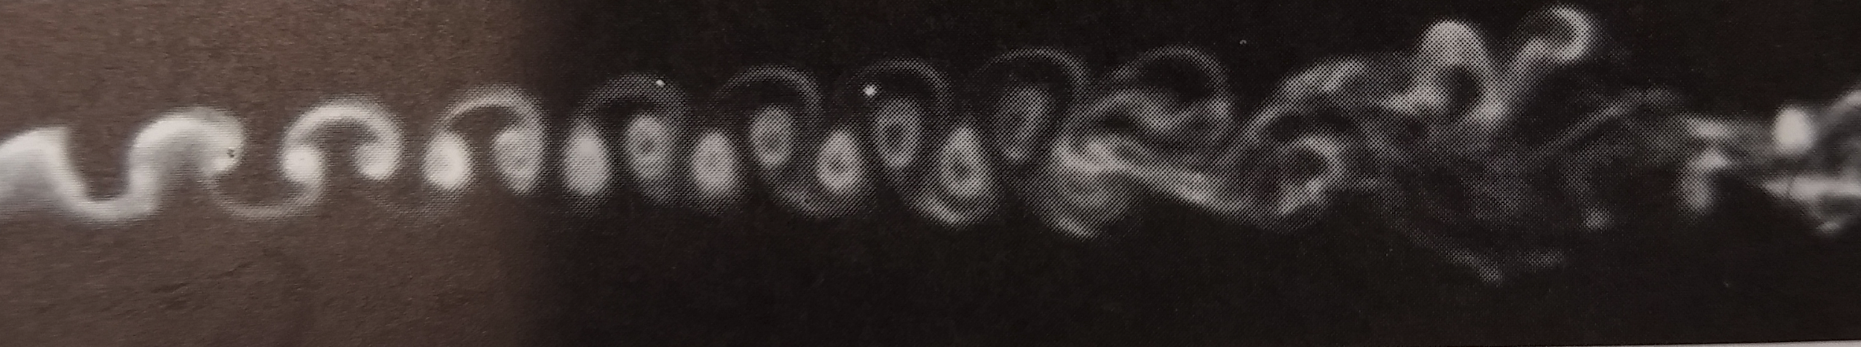
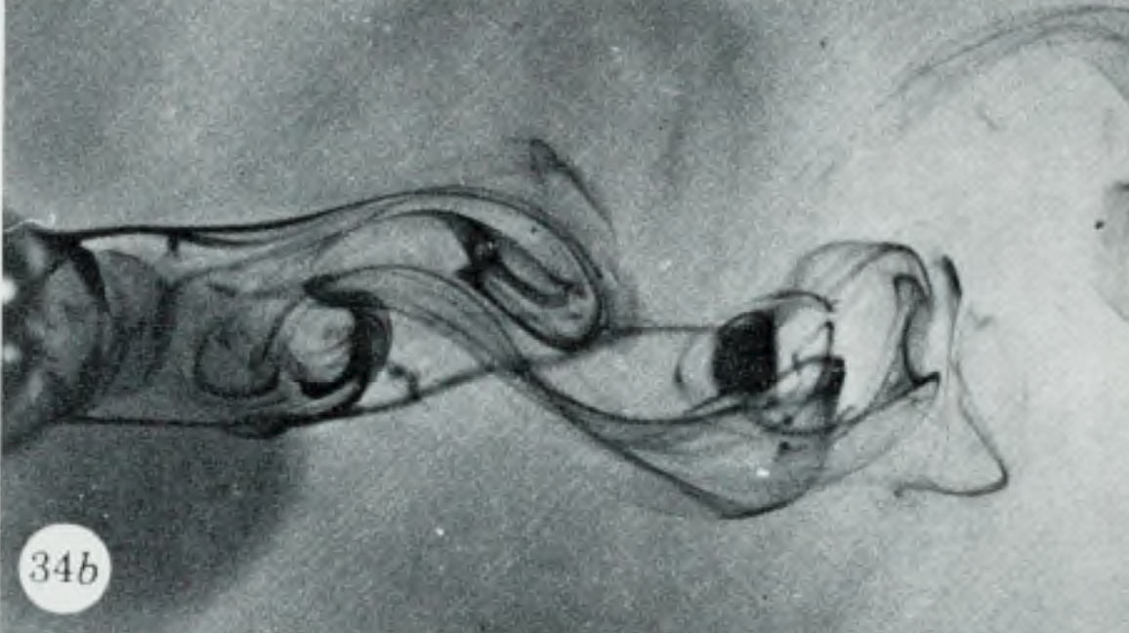
Flow around a cylinder
PERIODIC LAMINAR
Zdravkovich, M. (1968)
Re = 100
TrW1
Zdravkovich, M. (1968)
Re = 190
TrW2
LAMINAR STATE REGIMES
Creeping Flow; 0 < Re < 4-5
Steady separation; 4-5 < Re < 30-48
Periodic laminar; 30-48 < Re < 180-200
TRANSITION IN WAKE
TrW1; 180-200 < Re < 220-250
TrW2; 220-250 < Re < 350-400
Gerrard, J. H. (1978)
Re = 344

Slide 5
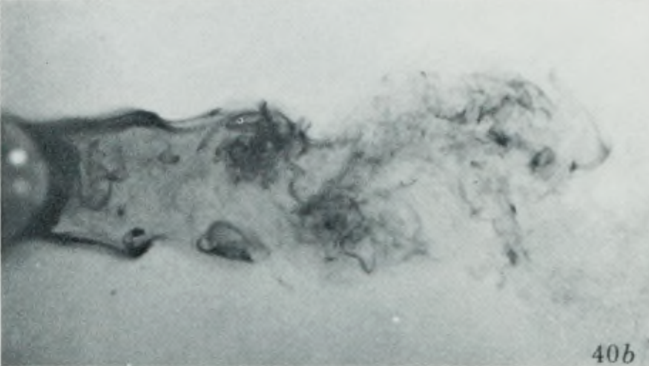
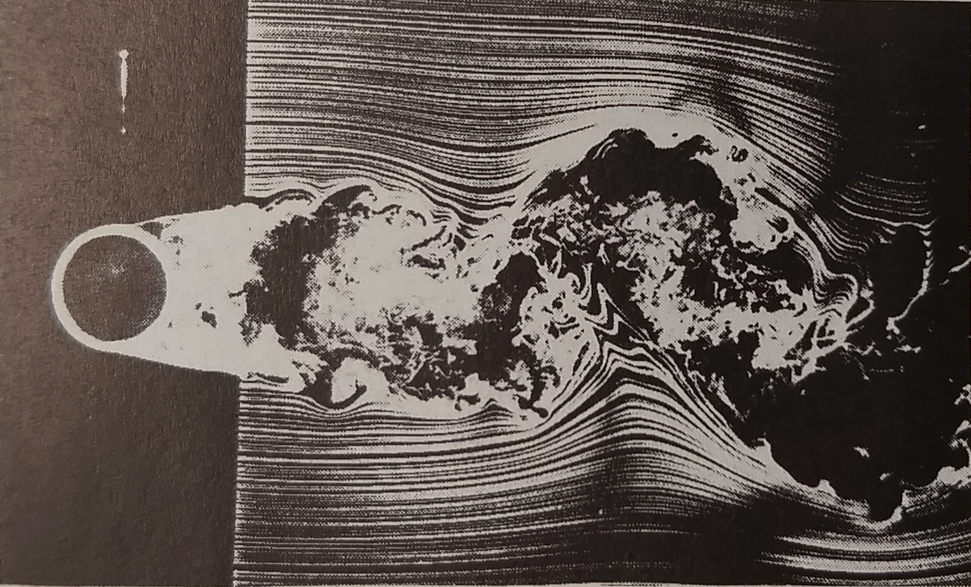
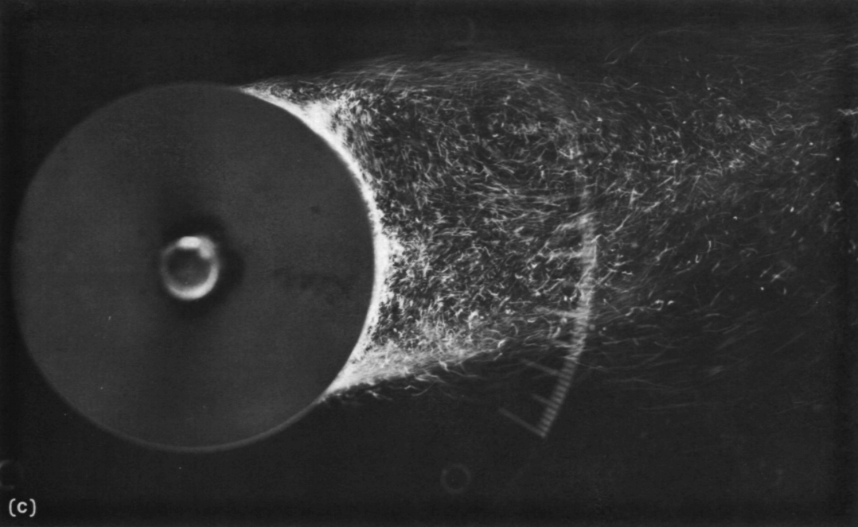
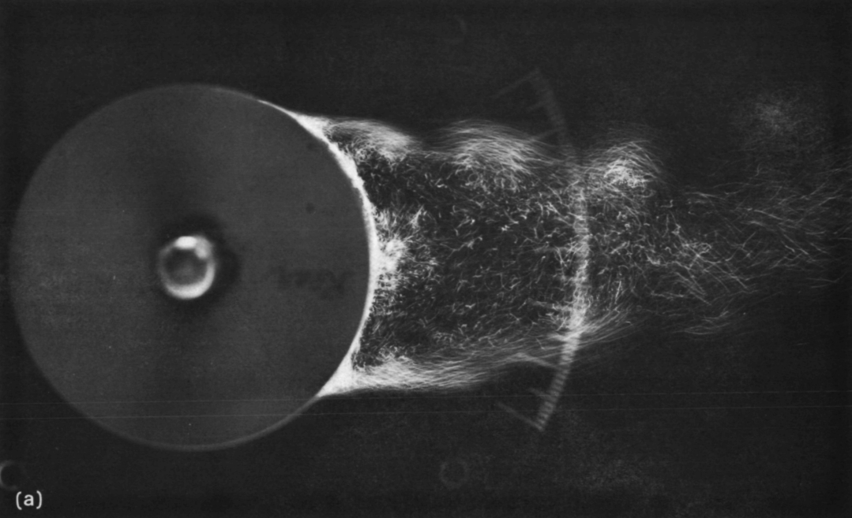
Flow around a cylinder
TrSL1
TrSL2
Gerrard-Bloor TW
Gerrard, J. H. (1978)
Re = 2000
TrBL1
Zdravkovich (1997)
Re = 8000
TRANSITION IN SHEAR LAYER
TrSL1: Transition waves; 350-400 < Re < 1k-2k
TrSL2: Transition Eddies; 1k-2k < Re < 20k-40k
TrSL3: Burst to turbulence; 20k-40k < Re < 100k-200k
TRANSITION IN BOUNDARY LAYER
TrBL0; precritical regime; 100k-200k < Re < 300k-400k
TrBL1: one-bubble regime; 300k-400k < Re < 380k-400k
TrBL2; two-bubble regime; 380k-400k < Re < 0.5M-1M
TrBL3; supercritical regime; 0.5M-1M < Re < 3.4M-6M
TrBL4; postcritical regime; 3.4M-6M < Re < unknown
FULLY TURBULENT FLOW
Re = 338k
TrBL2
Re = 374k
Almosino (1984)

Slide 6
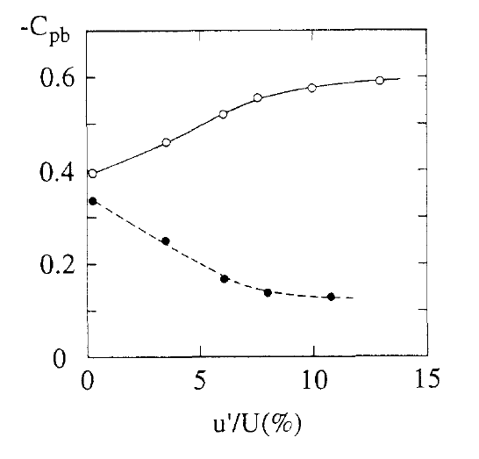
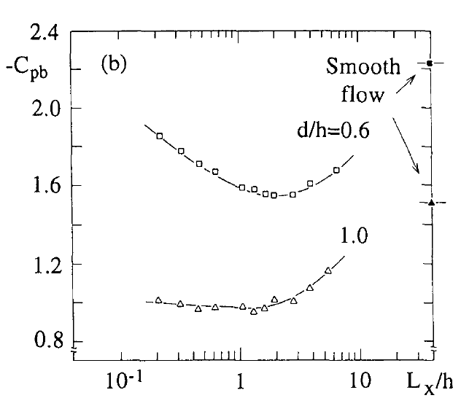
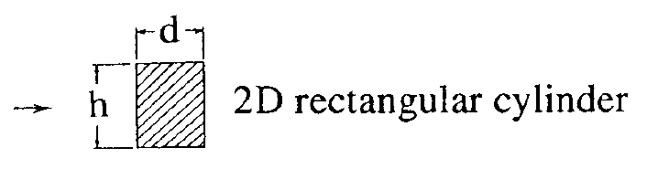
Influence of FS turbulence
Free stream turbulence affects flow around bluff bodies
C_{D}, C_{L}, C_{P} = f( u’/U , Lx/h )
Turbulence Intensity
Turbulence lengthscale (Integral lengthscale)
Square Plate
Cube
Nakamura (1993)

Slide 7
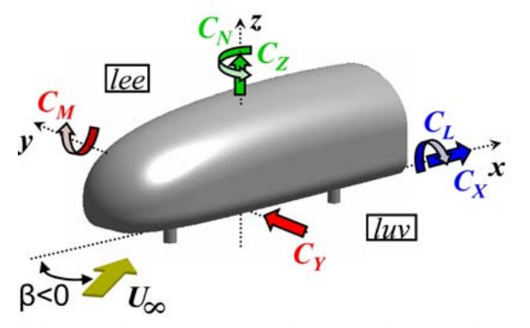
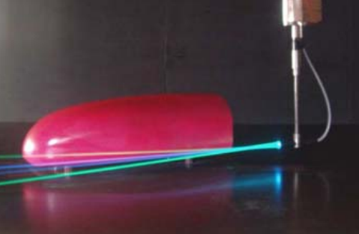
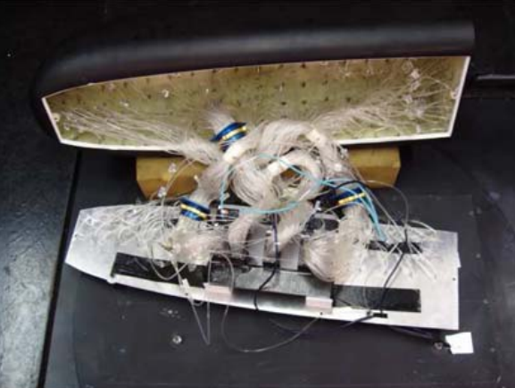
Exp methods: Example 1
3D-Bluff-Body crossflow (Gohlke et.al 2007)
Trains - Trucks
PIV
Force measurements - Gauges
249 Pressure sensors
Oil flow - Time averaged flow patterns - Separation and reattachment.
Laser Doppler velocimetry

Slide 8
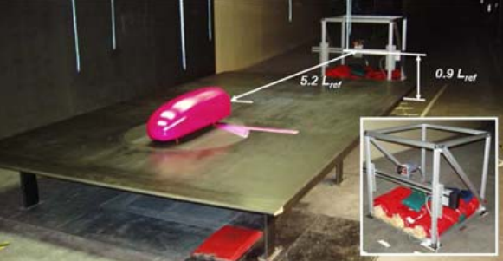
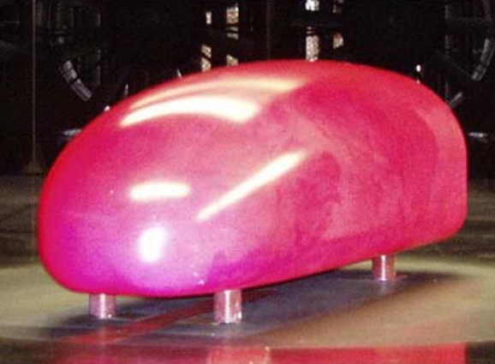
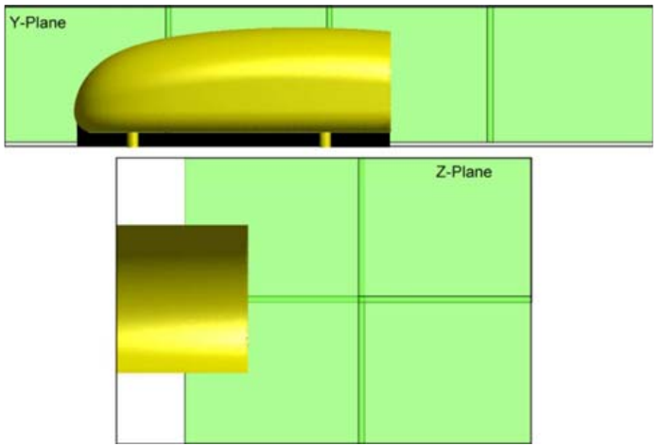
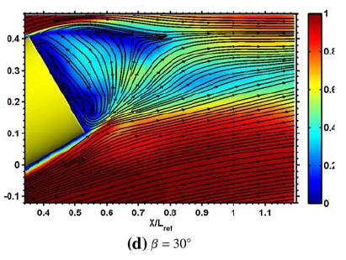
Exp methods: Example 1
Golhke et.al (2007)

Slide 9
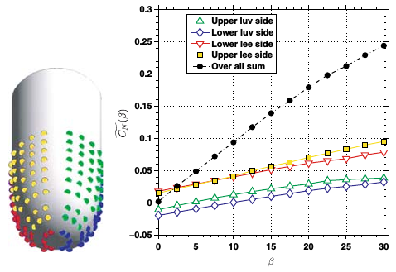
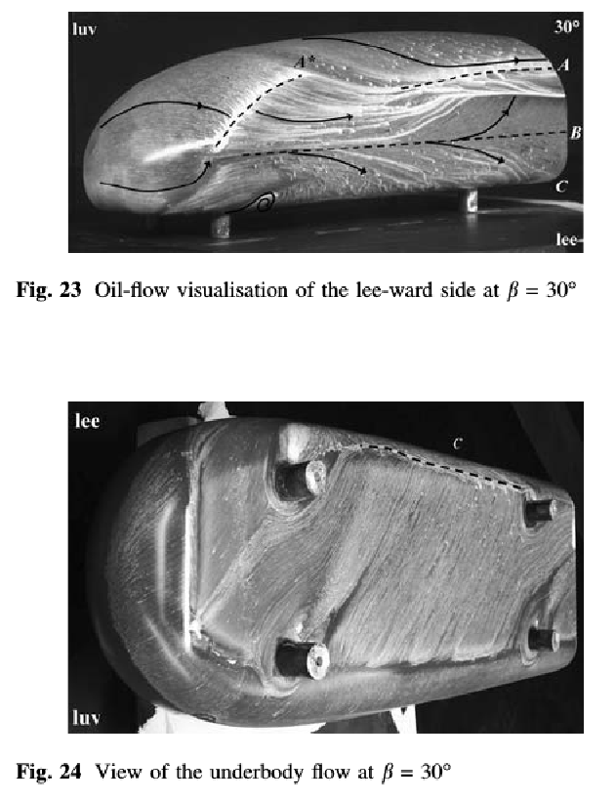
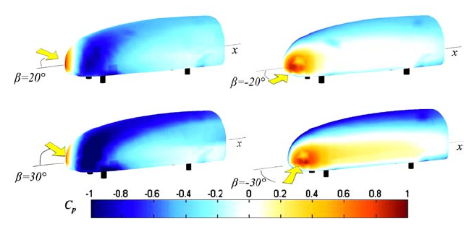
Exp methods: Example 1
Golhke et.al (2007)

Slide 10
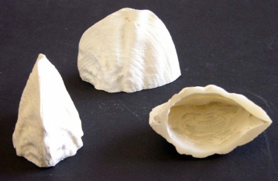
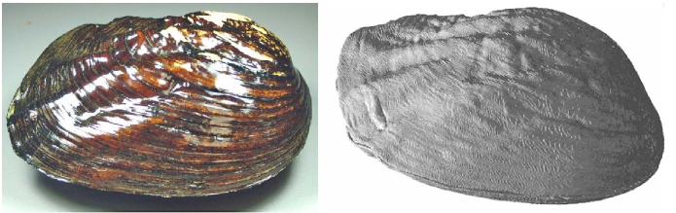
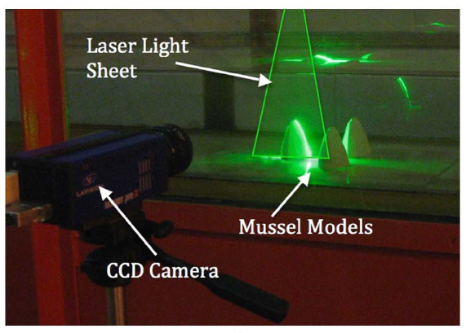
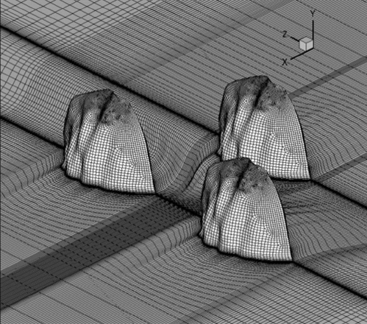
Exp methods: Example 2
Flow and Turbulence structures around Mussels. Constantinescu et al (2013)
Computerized axial tomography (CAT)
Physical model. Injection technique from CAT
Megalonaias nervosa

Slide 11
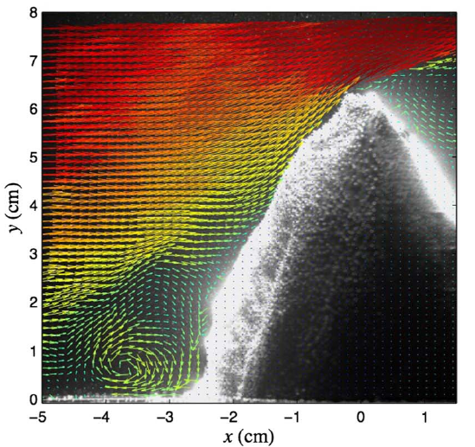
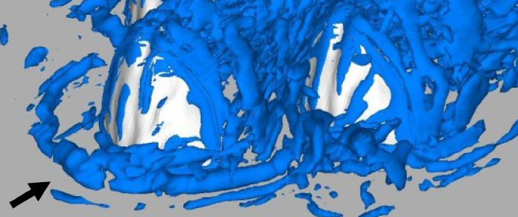
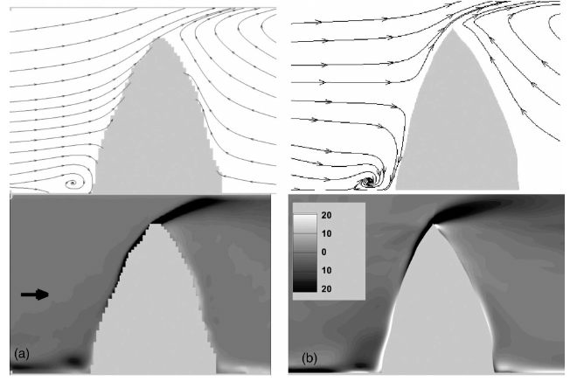
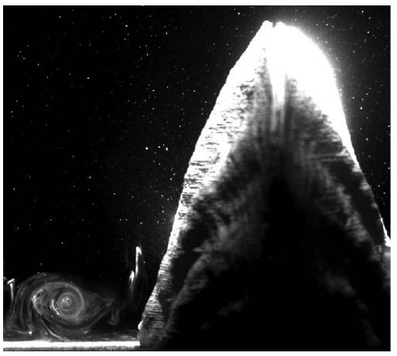
Exp methods: Example 2
PIV
LES
PIV
LES
Constantinescu et.al (2013)

Slide 12
Turbulence Modeling Overview
Direct Numerical Simulation (DNS)
Solve Navier-Stokes equations directly (no modeling)
Must resolve all turbulence scales on grid
Reynolds-Averaged Navier-Stokes (RANS)
Decompose into mean and perturbation quantities, simplify
Model turbulence (typically with eddy viscosity relations)
Unsteady RANS (URANS)
Global time stepping, capture unsteady behavior in mean flow
Large Eddy Simulation (LES)
Solve large turbulent structures directly on grid (DNS)
Model small turbulence with subgrid-scale (SGS) model
Detached Eddy Simulation (DES)
Hybrid RANS/LES: Use RANS near wall instead of SGS
Scale Adaptive Simulation (SAS)
RANS-like model that adjusts with von Karman length-scale
Allows turbulent spectrum to develop (LES-like)
Notes:
Will not go into detail
URANS = all grid cells must be solved at same time (global time stepping/time accurate)
DES will be used to describe LES
SAS = Like RANS but adjustable length scale allows resolved turbulent spectrum

Slide 13
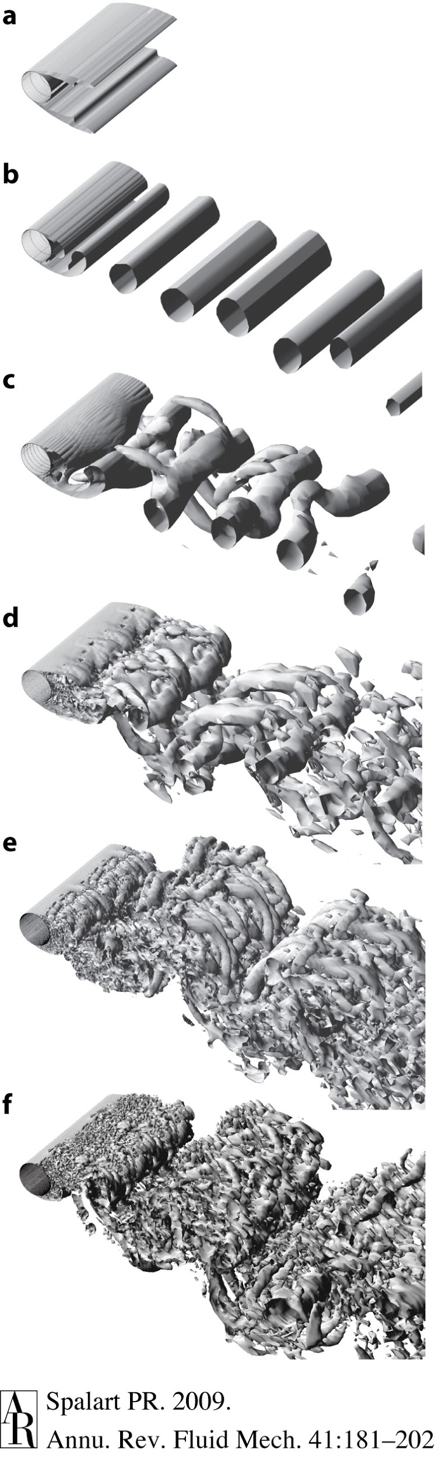
Simulation Comparisons
Vorticity isosurfaces over a circular cylinder
Experiment: Re=5e4, Cd=1.15-1.25
Steady RANS (SST)
Cd=0.78
Coarse DES (SA)
Cd=1.15
2D URANS (SST)
Cd=1.73
Fine DES (SA)
Cd=1.26
3D URANS (SST)
Cd=1.24
Fine DES (SST)
Cd=1.28
Spalart (2009)
Notes:
Simplest bluff body: circular cylinder
Comparing turbulence models to experiment
2D RANS: simple shear layer, incorrect drag coefficient
3D URANS: More complex, unsteady wake, better drag
DES: grid size and RANS turbulence model
Better flow than RANS, Ambigious behavior for drag, due to grid

Slide 14
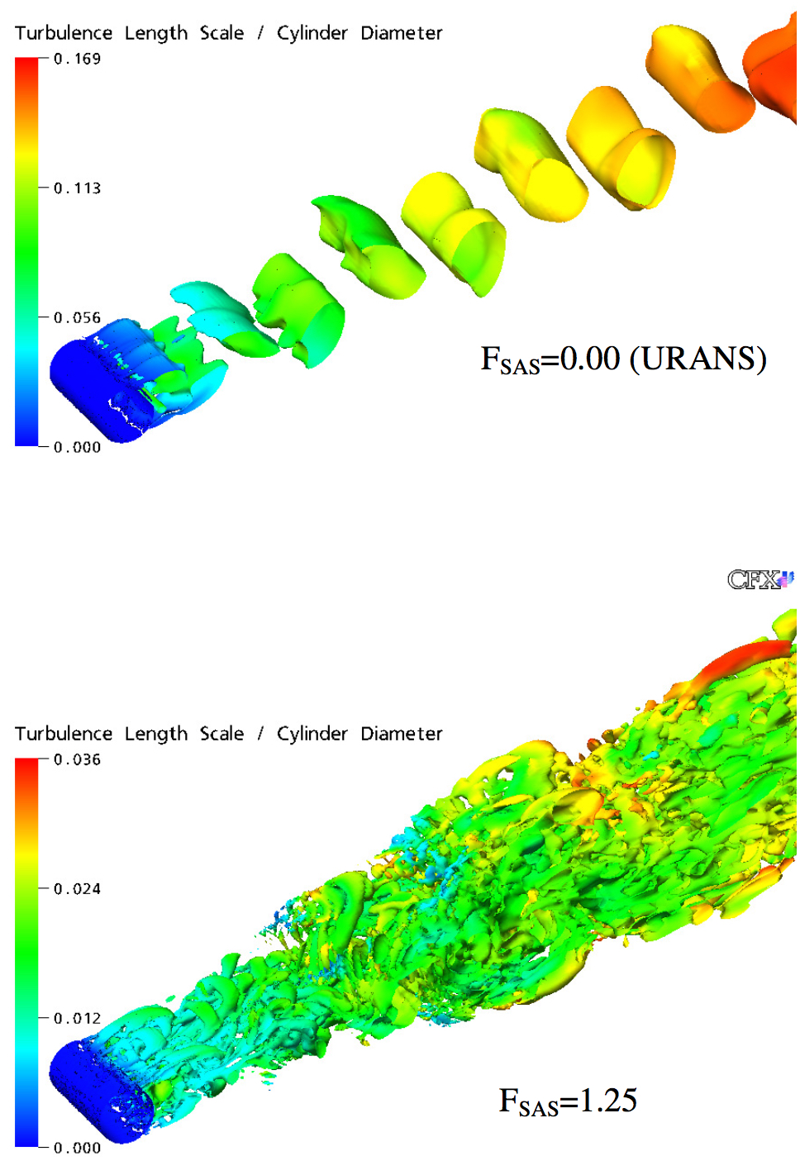
Simulation Comparisons
SAS attempts to avoid ambiguous grid dependencies of DES
Steady RANS (SST)
Cd=0.78
Coarse DES (SA)
Cd=1.15
Menter (2005)
2D URANS (SST)
Cd=1.73
Fine DES (SA)
Cd=1.26
3D URANS (SST)
Cd=1.24
Fine DES (SST)
Cd=1.28
Spalart (2009)
Notes:
SAS: URANS on left, LES-like on right
Potential alternative to DES

Slide 15
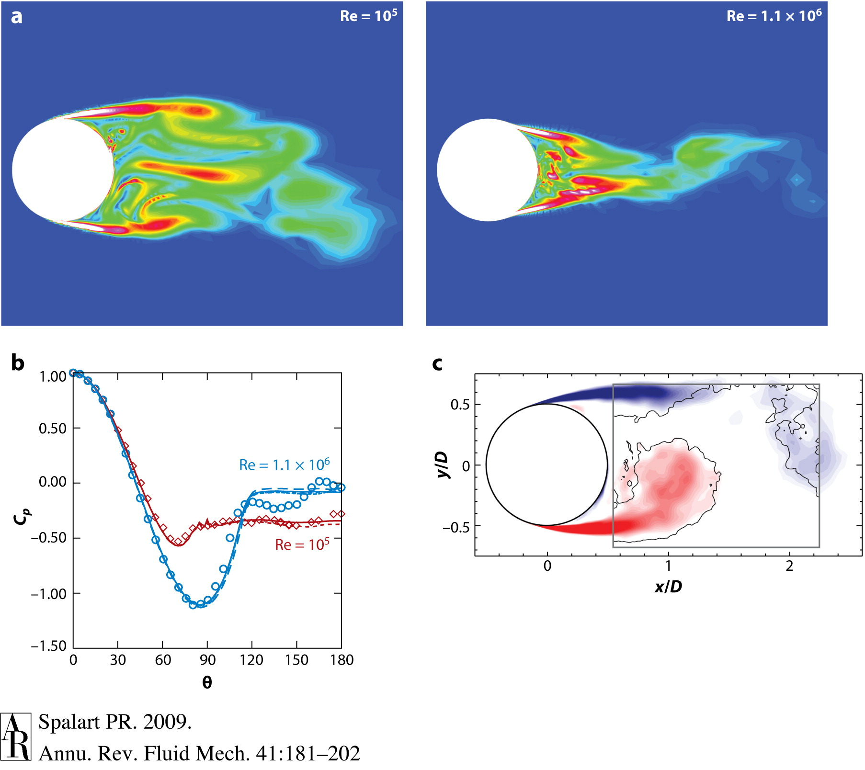
Simulation Successes
DES flow over a sphere (controlled separation)
Laminar Separation
Turbulent Separation
Surface pressure compared to experiment (left)
Vorticity contours compared to experiment (above)
Notes:
Does modeling work? Yes, in the correct situations
Sphere with controlled separation
Major difference in surface pressure is indicative of drag crisis
Modeling physics of turbulent separation (golf ball dimples) requires DNS

Slide 16
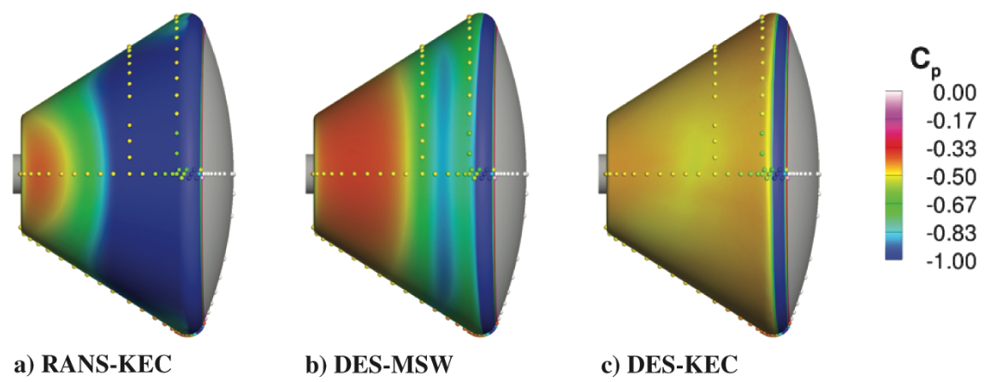
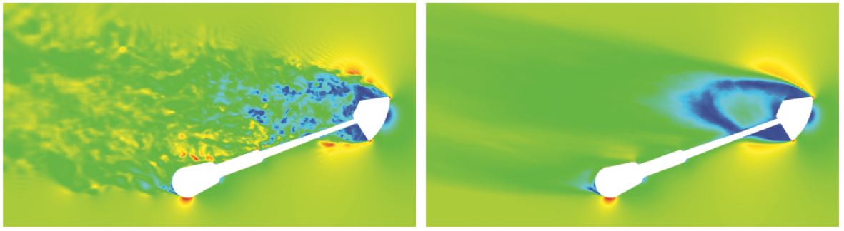
DES vs URANS (Capsule)
Wind Tunnel (dots) and URANS/DES (Schwing et al. 2009)
M=0.5, Re=5e6
Surface pressure: DES (right) closer match than RANS
Capsule Surface Pressure Coefficient
Instantaneous Time-averaged
Mach Contours
Notes:
More complex case: subsonic capsule
Compare time-averaged performance of RANS to DES to WTT
DES more accurate time averaged for specific cases

Slide 17
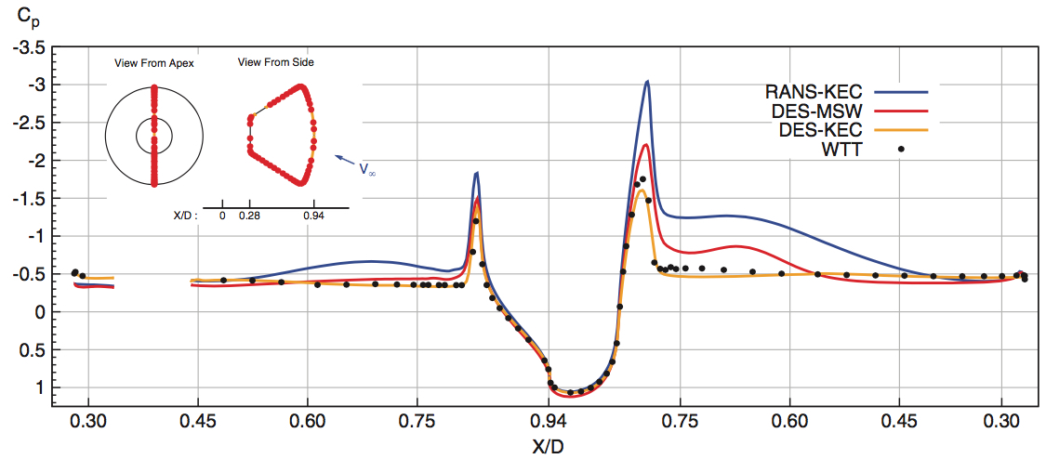
DES vs URANS Cont.
DES outperforms URANS in suction peak/base pressure prediction: more correct drag integration
But URANS more correctly predicts lift integration
Capsule Surface Pressure Coefficient
Instantaneous Time-averaged
Mach Contours
Notes:
Surface pressure distribution around capsule, look at finer flow features
Dots are WTT, DES matchs suction peak, base pressure better: better integrated drag
Blue line RANS integrates better lift
DES is not end-all solution to bluff body simulations

Slide 18
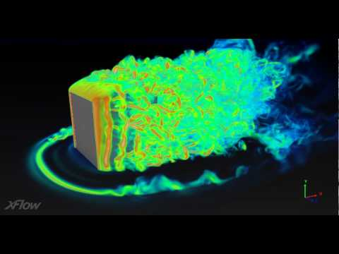
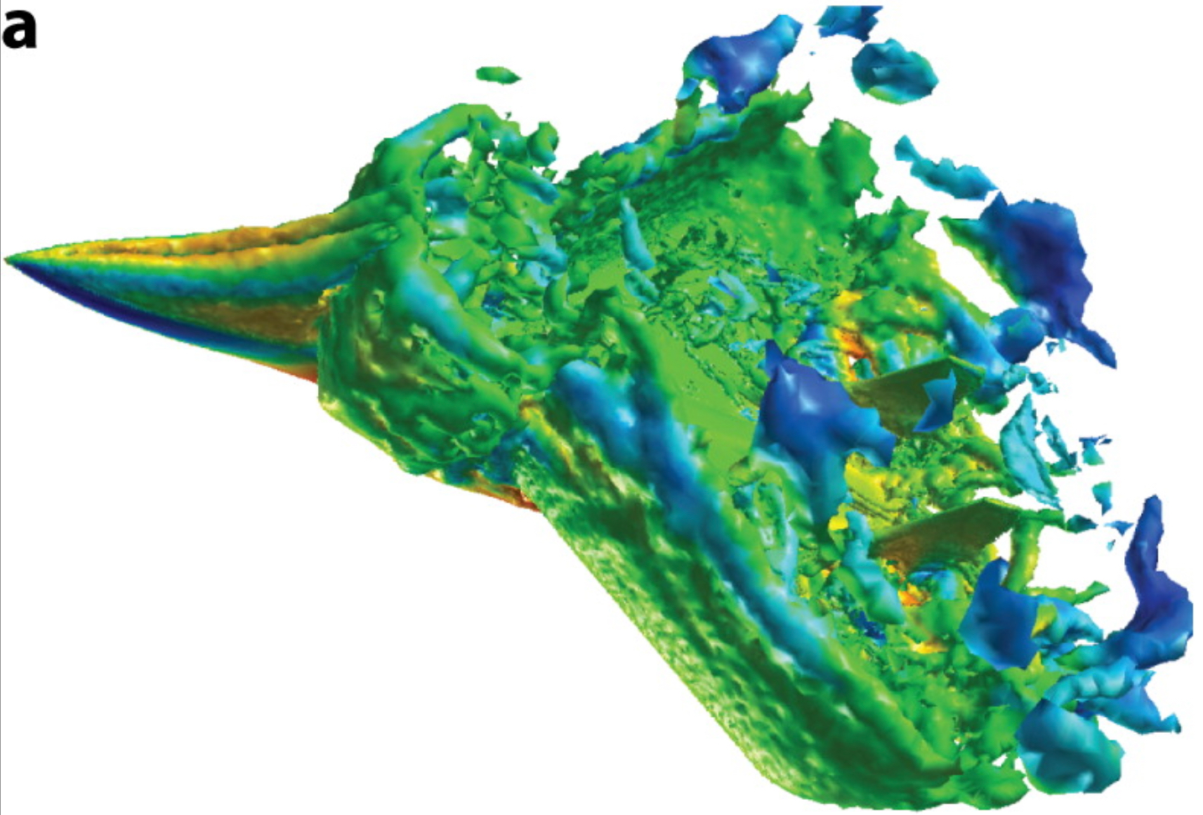
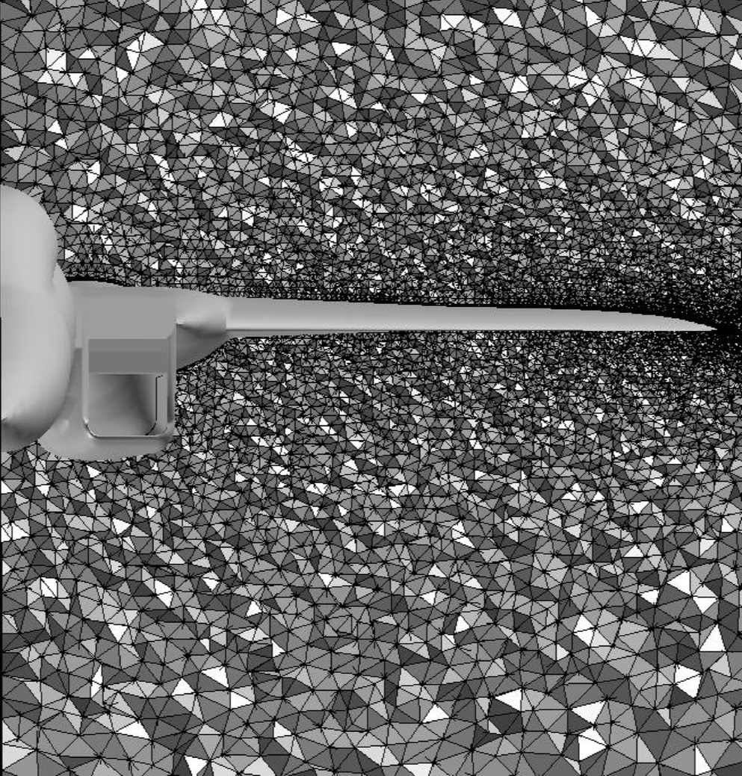
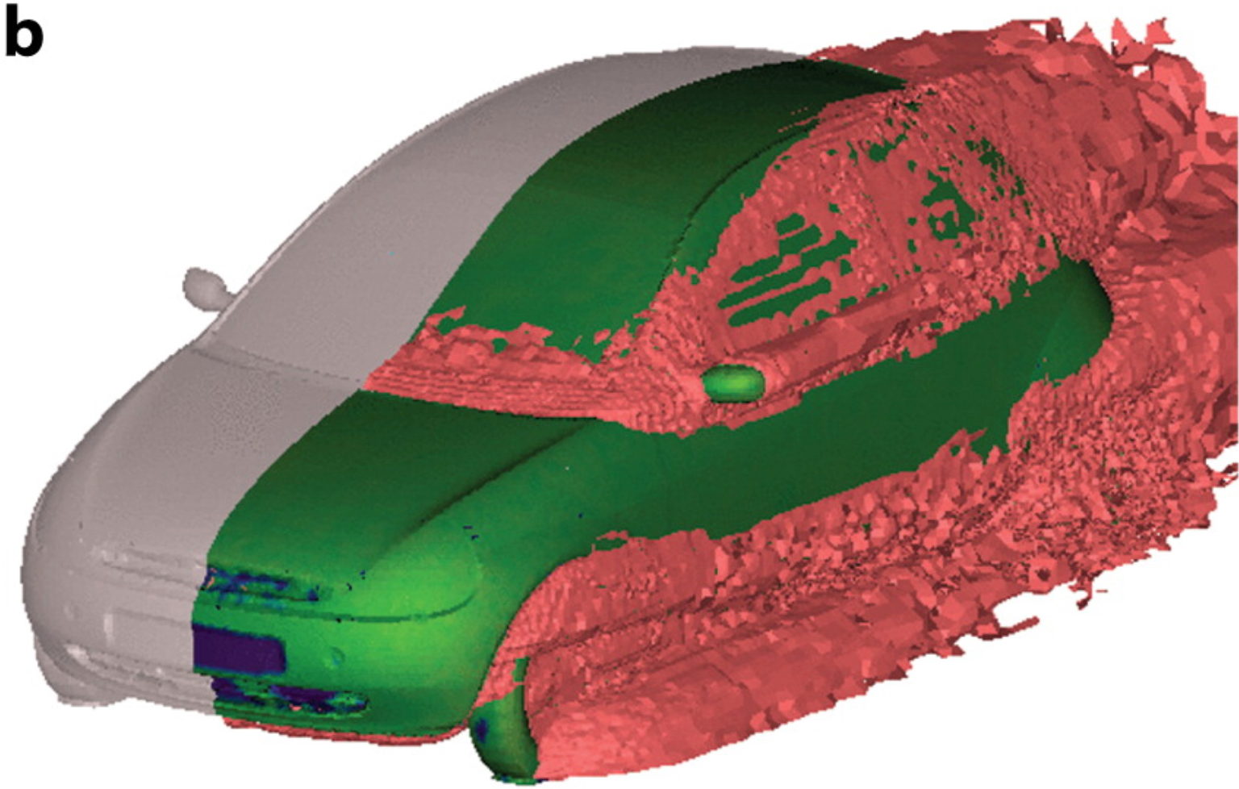
Other Complex Applications
LES of wall-mounted cube (Xflow)
F-15 at AoA=65deg (vorticity)
(Forsythe et al. 2004)
Acoustic-source isosurface over car
(Mendonca et al. 2002)
Notes:
DES/LES can be applied to complex geometries, massively separated flow

Slide 19
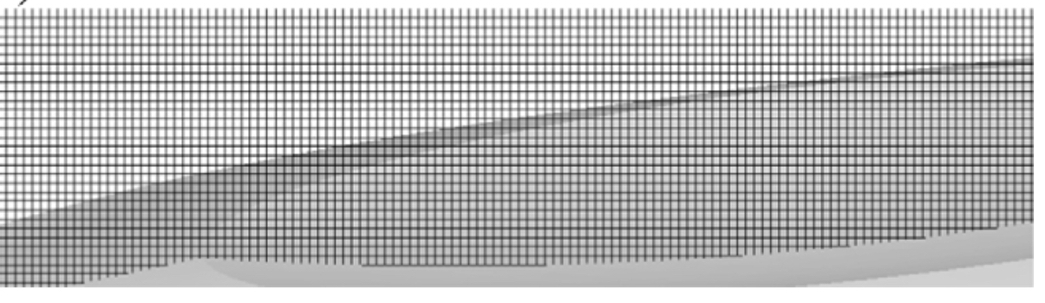
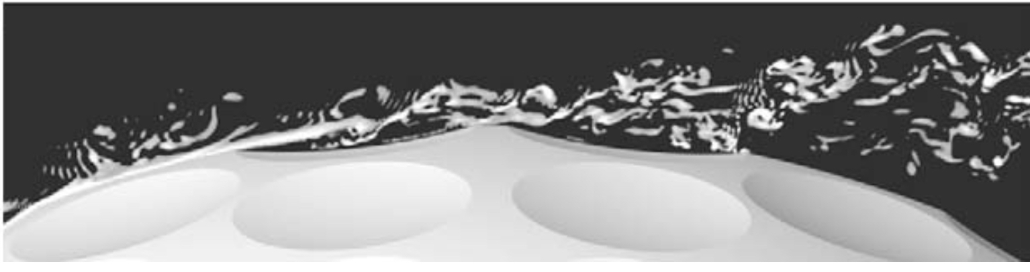
Current State: Bluff Body CFD
URANS
+ Least-expensive/most used in industry
+ Good for averaged loads (lift more than drag)
- Unable to resolve true turbulence behaviour in all situations
DES
+ More accurate unsteady behavior/turbulence spectra
+ “Functional” version of LES
- Order of accuracy unquantified (hybrid nature)
- Grid induced separation, not “plug-and-play”
SAS:
+ No grid induced separation
- Still modeling turbulence
DNS:
+ No turbulence modeling
- Cost prohibitive grids
DNS: Non-rotating golf ball with dimples
Re=1.1e5 (Smith et al. 2010)
Notes:
Bottom line, what would you use today to model a bluff body?
It depends
Start with URANS
DES for more complex results
SAS if DES doesn’t work
DNS not feasible

Slide 20
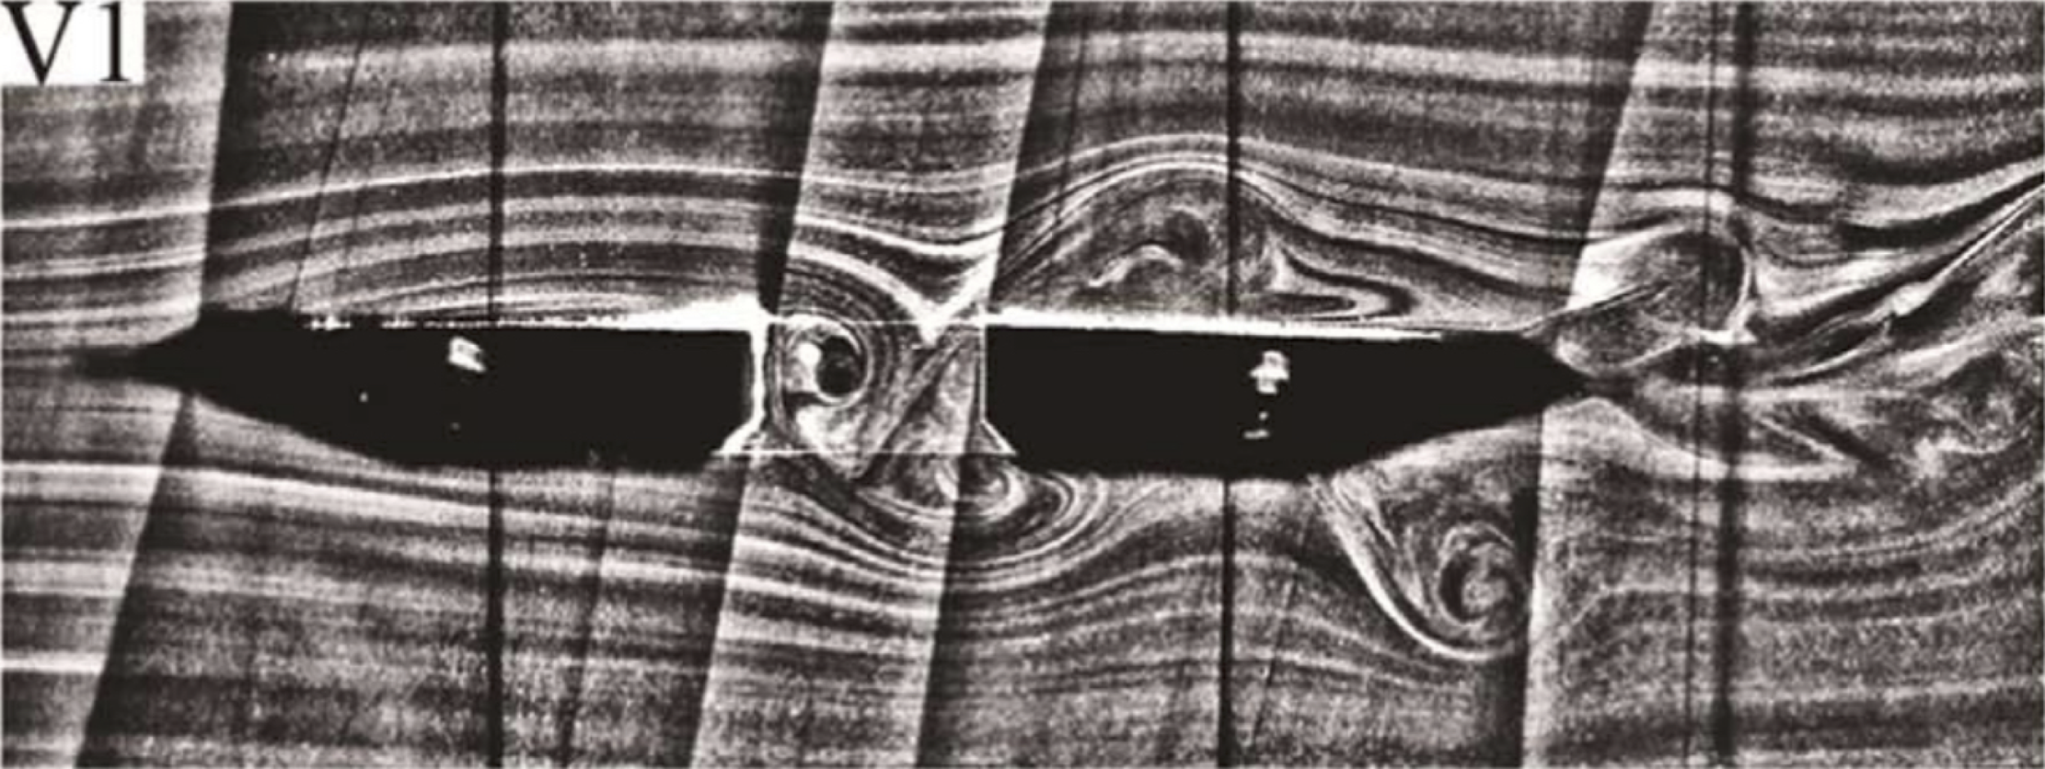
Questions?
Wind Tunnel Test of Bridge Span (PIV)
(Yuan et al. 2017)

Slide 21
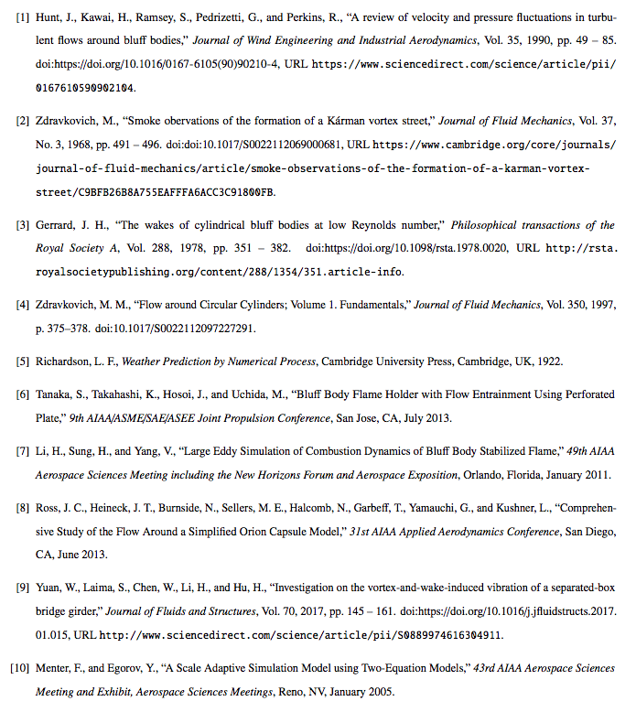
References

Slide 22
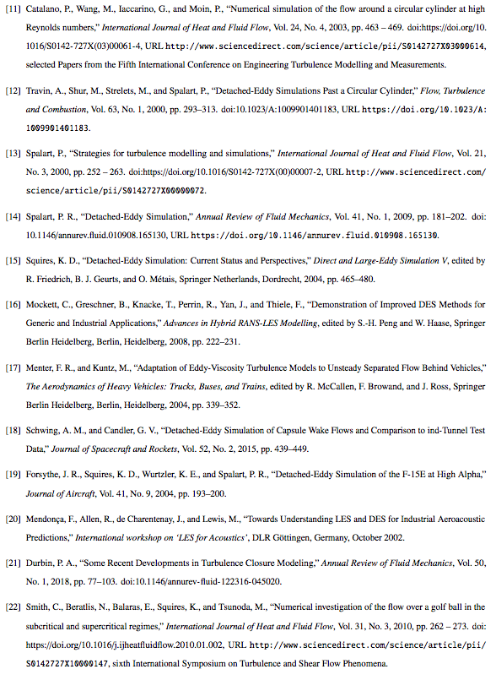
References

Slide 23

References

Slide 24



Backup: Grids
Clockwise: reentry capsule (DES), non-rotating golf ball (DNS), Grid Induced Separation on airfoil (DES), Circular Cylinder (DES)

